Slide 1
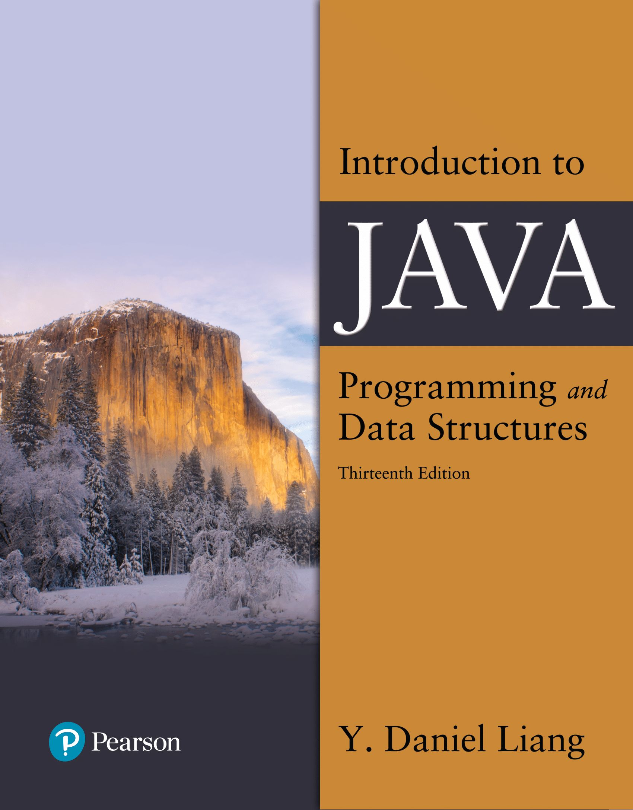

Introduction to Java Programming and Data Structures
Thirteenth Edition
Chapter 3
Selections
Copyright © 2024 Pearson Education, Inc. All Rights Reserved
Notes:
If this PowerPoint presentation contains mathematical equations, you may need to check that your computer has the following installed:
1) MathType Plugin
2) Math Player (free versions available)
3) NVDA Reader (free versions available)
Slides in this presentation contain hyperlinks. JAWS users should be able to get a list of links by using INSERT+F7

Slide 2
Motivations
If you assigned a negative value for radius in program, CircleArea.java, the program would print an invalid result. If the radius is negative, you don't want the program to compute the area. How can you deal with this situation?

Slide 3
Review
Four types of program control
Sequence
Selection
Iteration
Subprograms
Sequence example
Given hours worked and pay rate, calculate gross pay.

Slide 4
Preview
Selection Program Control
Make decisions and execute alternative statements based on the result of your decision.
Example
Given hours worked and pay rate, calculate gross pay. Overtime (over 40 hours is paid 1.5)

Slide 5
The boolean Type and Operators
Often in a program you need to compare two values, such as whether i is greater than j. Java provides six comparison operators (also known as relational operators) that can be used to compare two values. The result of the comparison is a Boolean value: true or false.
boolean b = (1 > 2);

Slide 6
Relational Operators
Java Operator | Mathematics Symbol | Name | Example (radius is 5) | Result
< | < | less than | radius < 0 | false
<= | Less than or equal to | less than or equal to | radius <= 0 | false
> | > | greater than | radius > 0 | true
>= | Greater than or equal to | greater than or equal to | radius >= 0 | true
== | = | equal to | radius == 0 | false
!= | Not equal to | not equal to | radius != 0 | true

Slide 7
Problem: A Simple Math Learning Tool
This example creates a program to let a first grader practice additions. The program randomly generates two single-digit integers number1 and number2 and displays a question such as “What is 7 + 9?” to the student. After the student types the answer, the program displays a message to indicate whether the answer is true or false.
AdditionQuiz
Notes:
AdditionQuiz: https://liveexample.pearsoncmg.com/html/AdditionQuiz.html

Slide 8
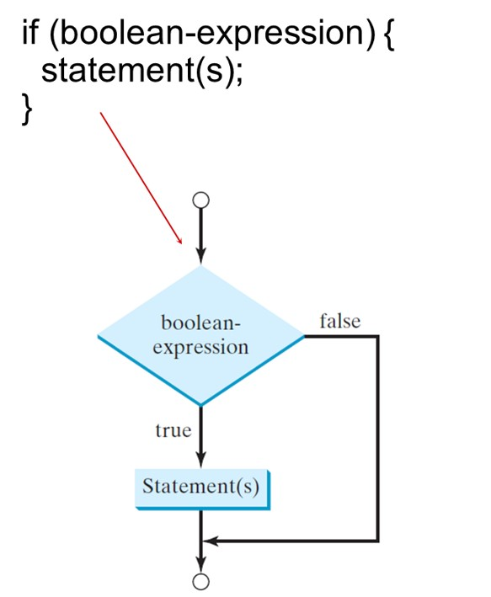
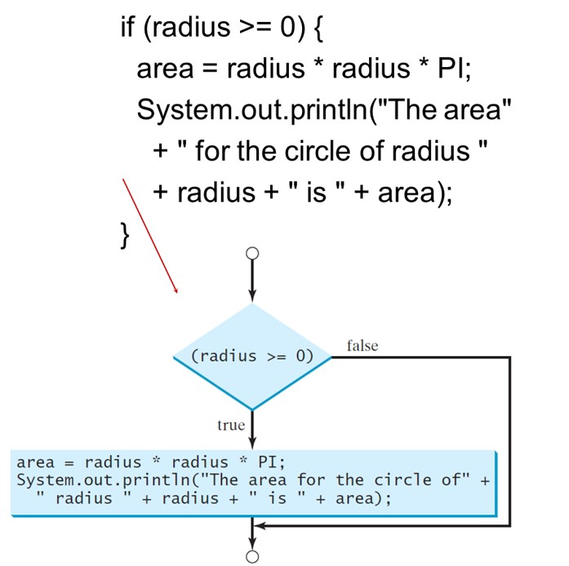
One-Way if Statements
Notes:
The decision box is labeled as left parenthesis radius greater than equal to 0 right parenthesis. If true, then compute area = radius times radius times P I; System.out.printIn left parenthesis double quotes open The area for the circle of double quotes close + double quotes open radius double quotes close + radius + double quotes open is double quotes close + area right parenthesis;. If false, then go to the step after the compute box.

Slide 9
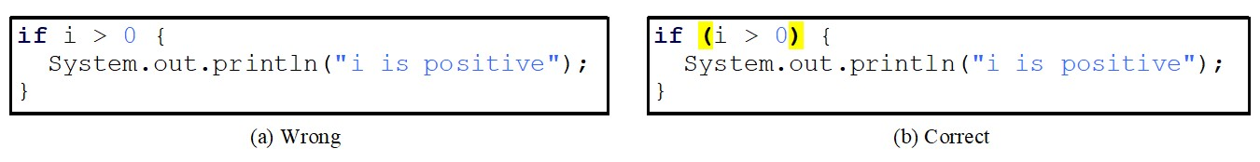
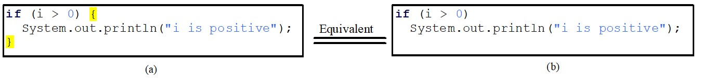
Note
Notes:
a. Wrong. if i is greater than 0 open curly bracket System.out.printIn left parenthesis double quotes open i is positive double quotes close right parenthesis; close curly bracket.
b. Correct. If left parenthesis i greater than 0 right parenthesis. The parentheses are highlighted. Open curly parenthesis System.out.printIn left parenthesis double quotes open i is positive double quotes close right parenthesis; close curly bracket.
a. if left parenthesis i is greater than 0 right parenthesis. Open curly bracket System.out.printIn left parenthesis double quotes open i is positive double quotes close right parenthesis; close curly bracket. The curly brackets are highlighted.
b. If left parenthesis i greater than 0 right parenthesis. System.out.printIn left parenthesis double quotes open i is positive double quotes close right parenthesis; close curly bracket.

Slide 10
Simple if Demo
Write a program that prompts the user to enter an integer. If the number is a multiple of 5, print Hi Five. If the number is divisible by 2, print Hi Even.
SimpleIfDemo
Notes:
SimpleIfDemo: https://liveexample.pearsoncmg.com/html/SimpleIfDemo.html

Slide 11
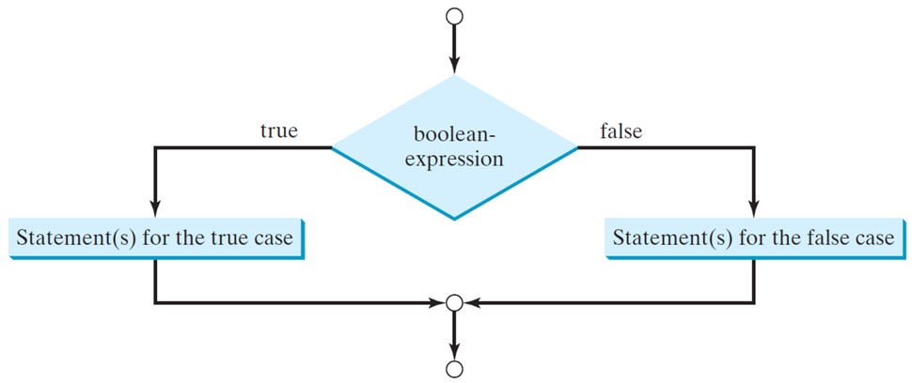
The Two-Way if Statement
if (boolean-expression) {
statement(s)-for-the-true-case;
}
else {
statement(s)-for-the-false-case;
}

Slide 12
if-else Example
if (radius >= 0) {
area = radius * radius * 3.14159;
System out.println("The area for the “
+ “circle of radius " + radius +
" is " + area);
}
else {
System.out.println("Negative input");
}

Slide 13
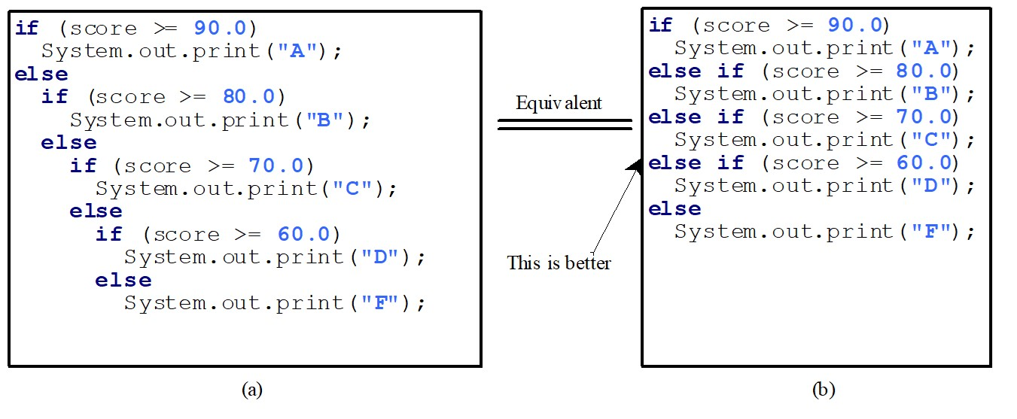
Multiple Alternative if Statements
Notes:
If left parenthesis score greater than equal to 90.0 right parenthesis
System.out.print left parenthesis double quotes open A double quotes close right parenthesis;
else
if left parenthesis score greater than equal to 80.0 right parenthesis System.out.print left parenthesis double quotes open B double quotes close right parenthesis;
else
if left parenthesis score greater than equal to 70.0 right parenthesis System.out.print left parenthesis double quotes open C double quotes close right parenthesis;
else
if left parenthesis score greater than equal to 60.0 right parenthesis System.out.print left parenthesis double quotes open D double quotes close right parenthesis;
else
System.out.print left parenthesis double quotes open F double quotes close right parenthesis;
It is equivalent to the following:
if left parenthesis score greater than equal to 90.0 right parenthesis System.out.print left parenthesis double quotes open A double quotes close right parenthesis;
else if left parenthesis score greater than equal to 80.0 right parenthesis System.out.print left parenthesis double quotes open B double quotes close right parenthesis;
else if left parenthesis score greater than equal to 70.0 right parenthesis System.out.print left parenthesis double quotes open C double quotes close right parenthesis;
else if left parenthesis score greater than equal to 60.0 right parenthesis System.out.print left parenthesis double quotes open D double quotes close right parenthesis;
else
System.out.print left parenthesis double quotes open F double quotes close right parenthesis;

Slide 14
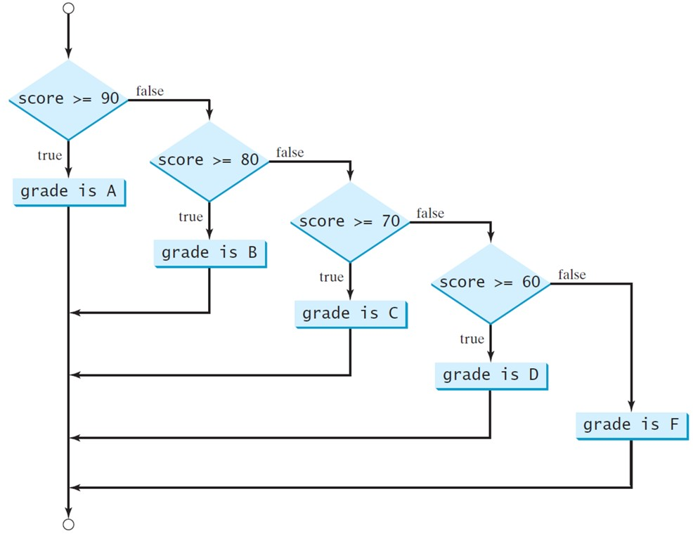
Multi-Way if-else Statements
Notes:
The flow chart starts from a point and moves to a decision box labeled, score greater than equal to 90. If true, grade is A. If false, score greater than equal to 80. If true, grade is B. If false, score greater than equal to 70. If true, grade is C. If false, score greater than equal to 60. If true, grade is D. If false, grade is F.
All the compute boxes merge with the compute box labeled grade is A and all of them together reach the ending point.

Slide 15
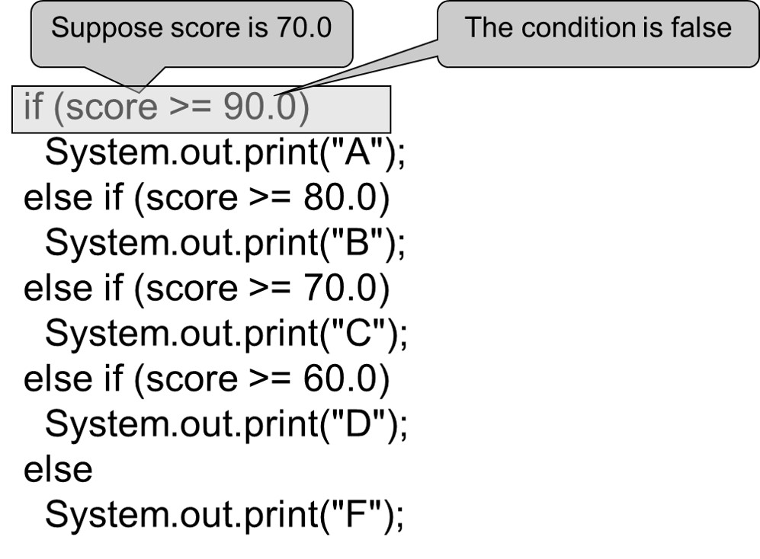
Trace if-else Statement (1 of 5)

Slide 16
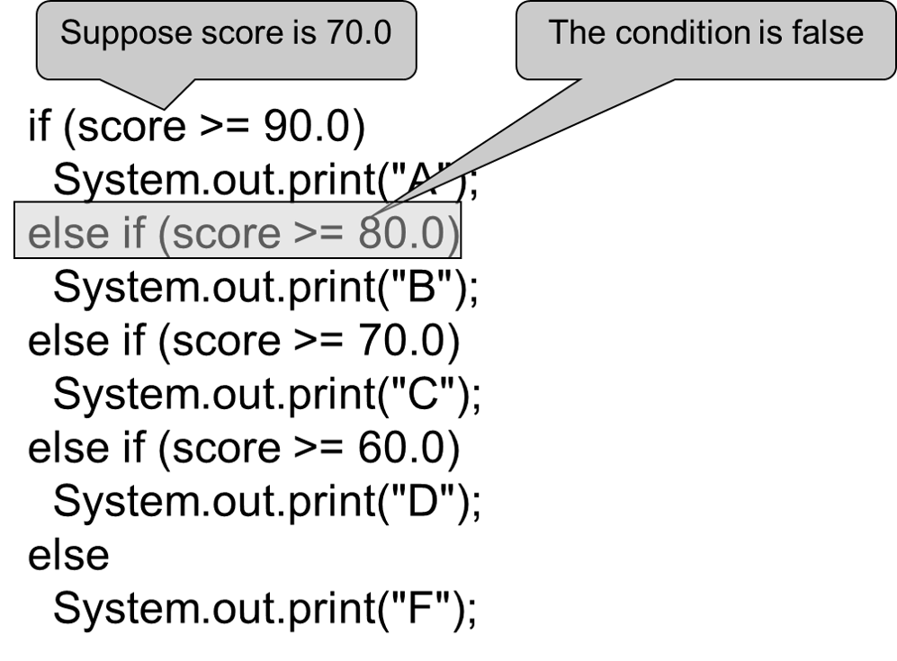
Trace if-else Statement (2 of 5)

Slide 17
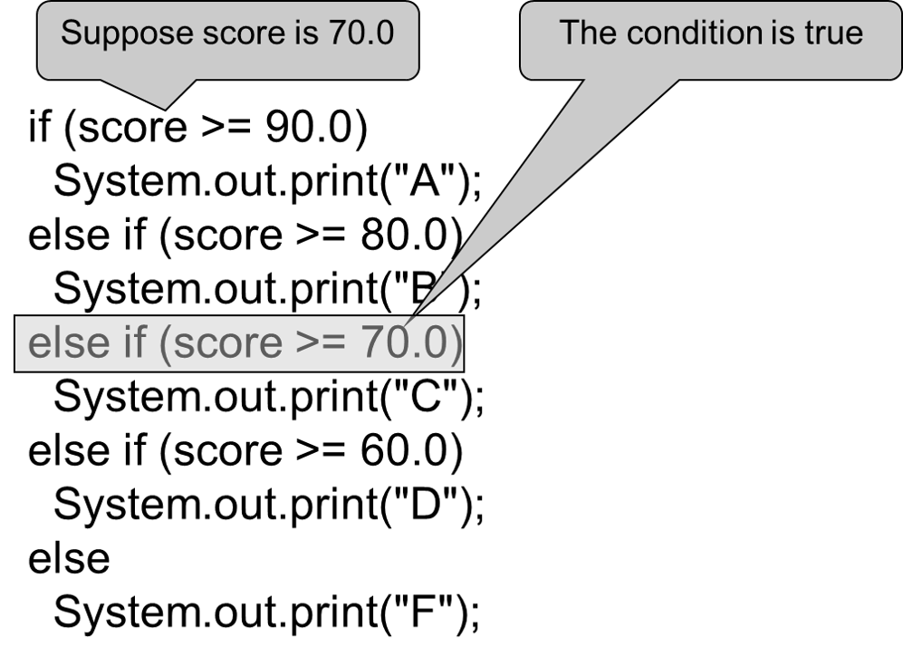
Trace if-else Statement (3 of 5)

Slide 18
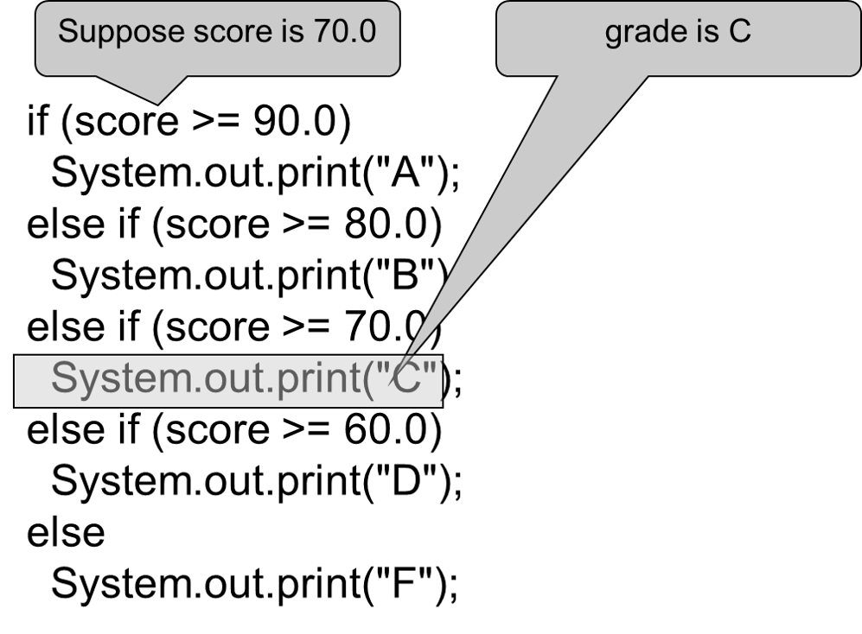
Trace if-else Statement (4 of 5)

Slide 19
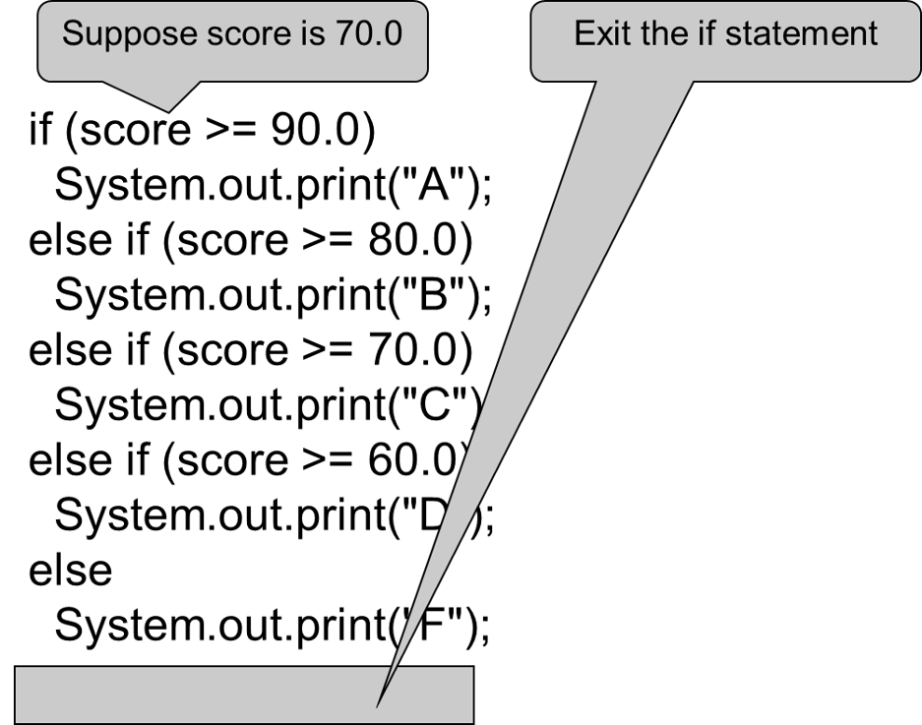
Trace if-else Statement (5 of 5)

Slide 20
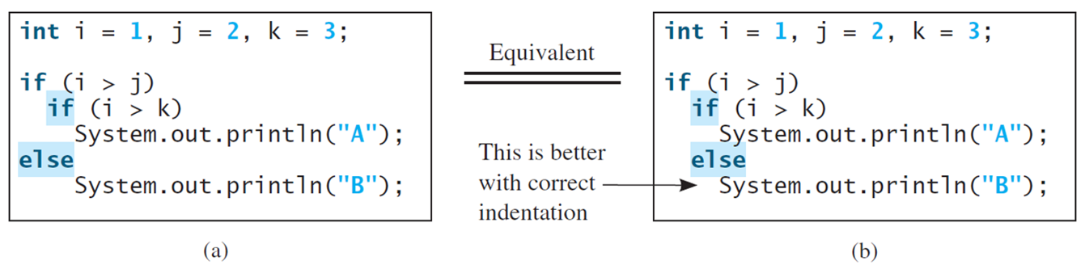
Note (1 of 2)
The else clause matches the most recent if clause in the same block.
Notes:
if left parenthesis i greater than j right parenthesis
if left parenthesis i greater than k right parenthesis System.out.printIn left parenthesis double quotes open A double quotes close right parenthesis;
else
System.out.printIn left parenthesis double quotes open A double quotes close right parenthesis;
It is equivalent to the following:
int i = 1, j = 2, k = 3;
if left parenthesis i greater than j right parenthesis
if left parenthesis i greater than k right parenthesis System.out.printIn left parenthesis double quotes open A double quotes close right parenthesis;
else
System.out.printIn left parenthesis double quotes open double quotes close right parenthesis;
An arrow points to the second case. The arrow is labeled This is better with correct indentation.

Slide 21
Note (2 of 2)
Nothing is printed from the preceding statement. To force the else clause to match the first if clause, you must add a pair of braces:
int i = 1;
int j = 2;
int k = 3;
if (i > j) {
if (i > k)
System.out.println("A");
}
else
System.out.println("B");
This statement prints B.

Slide 22
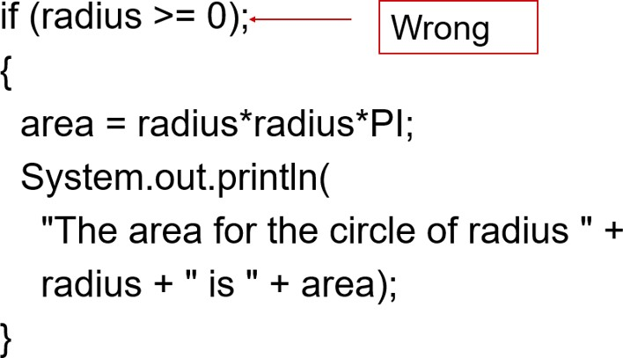
Common Errors
Adding a semicolon at the end of an if clause is a common mistake.
This mistake is hard to find, because it is not a compilation error or a runtime error, it is a logic error.
This error often occurs when you use the next-line block style.
Notes:
left brace
area = radius times radius time pi semi colon
System.out.println left parenthesis
start quotation marks The area for the circle of radius end quotation marks + radius + start quotation marks is end quotation marks + area right parenthesis semi colon
right brace

Slide 23
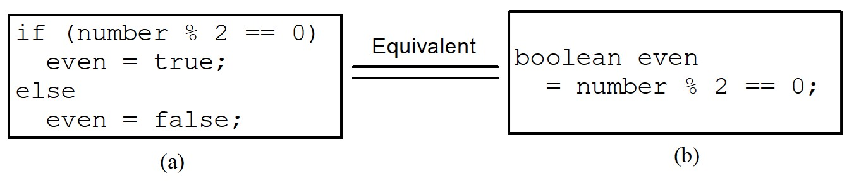
T I P
Notes:
Image a
if left parenthesis even is equal to true right parenthesis.
System.out.printIn left parenthesis double quotes It is even. Double quotes right parenthesis;
Image b
if left parenthesis even right parenthesis
System.out.printIn left parenthesis double quotes It is even. double quotes right parenthesis;
A double line between both the images is labeled, Equivalent.

Slide 24
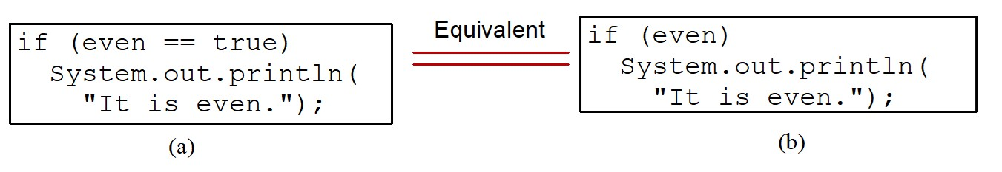
Caution
Notes:
Row 1. B M I: B M I less than 18.5. Interpretation: Underweight.
Row 2. B M I: 18.5 less than equal to B M I less than 25.0. Interpretation: Normal.
Row 3. B M I: 25.0 less than equal to B M I less than 30.0. Interpretation: Overweight.
Row 2. B M I: B M I is greater than equal to 30.0. Interpretation: Obese.
Compute And Interpret B M I are written together without any gaps between the words.

Slide 25
Problem: An Improved Math Learning Tool
This example creates a program to teach a first grade child how to learn subtractions. The program randomly generates two single-digit integers number1 and number2 with number1 >= number2 and displays a question such
as “What is
to the student. After the student types
the answer, the program displays whether the answer is correct.
SubtractionQuiz
Notes:
SubtractionQuiz: https://liveexample.pearsoncmg.com/html/SubtractionQuiz.html

Slide 26
Logical Operators
Operator | Name | Description
! | not | logical negation
&& | and | logical conjunction
|| | or | logical disjunction
^ | exclusive or | logical exclusion

Slide 27
Truth Table for Operator !
p | !p | Example (assume age = 24, weight = 140)
true | false | !(age > 18) is false, because (age > 18) is true.
false | true | !(weight == 150) is true, because (weight == 150) is false.

Slide 28
Truth Table for Operator &&
p sub 1 | p sub 1 | p sub 1 and p sub 2 | Example (assume age = 24, weight = 140)
false | false | false | (age <= 18) && (weight < 140) is false, because both conditions are both false.
false | true | false | Blank
true | false | false | (age > 18) && (weight > 140) is false, because (weight > 140) is false.
true | true | true | (age > 18) && (weight >= 140) is true, because both (age > 18) and (weight >= 140) are true.

Slide 29
Truth Table for Operator ||
p sub 1 | p sub 2 | p sub 1 or p sub 2 | Example (assume age = 24, weight = 140)
false | false | false | Blank
false | true | true | (age > 34) || (weight <= 140) is true, because (age > 34) is false, but (weight <= 140) is true.
true | false | true | (age > 14) || (weight >= 150) is false, because (age > 14) is true.
true | true | true | Blank

Slide 30
Truth Table for Operator ^
p sub 1 | p sub 2 | p sub 1 exclusive or p sub 2 | Example (assume age = 24, weight = 140)
false | false | false | (age > 34) ^ (weight > 140) is true, because (age > 34) is false and (weight > 140) is false.
false | true | true | (age > 34) ^ (weight >= 140) is true, because (age > 34) is false but (weight >= 140) is true.
true | false | true | (age > 14) ^ (weight > 140) is true, because (age > 14) is true and (weight > 140) is false.
true | true | false | blank

Slide 31
Examples (1 of 2)
Here is a program that checks whether a number is divisible by 2 and 3, whether a number is divisible by 2 or 3, and whether a number is divisible by 2 or 3 but not both:
TestBooleanOperators
Notes:
TestBooleanOperators: https://liveexample.pearsoncmg.com/html/SubtractionQuiz.html

Slide 32
Examples (2 of 2)
System.out.println("Is " + number + " divisible by 2 and 3? " +
((number % 2 == 0) && (number % 3 == 0)));
System.out.println("Is " + number + " divisible by 2 or 3? " +
((number % 2 == 0) || (number % 3 == 0)));
System.out.println("Is " + number +
" divisible by 2 or 3, but not both? " +
((number % 2 == 0) ^ (number % 3 == 0)));
TestBooleanOperators
Notes:
TestBooleanOperators: https://liveexample.pearsoncmg.com/html/SubtractionQuiz.html

Slide 33
Problem: Determining Leap Year?
This program first prompts the user to enter a year as an int value and checks if it is a leap year.
A year is a leap year if it is divisible by 4 but not by 100, or it is divisible by 400.
(year % 4 == 0 && year % 100 != 0) || (year % 400 == 0)
LeapYear
Notes:
LeapYear: https://liveexample.pearsoncmg.com/html/LeapYear.html

Slide 34
switch Statements
switch (status) {
case 0: compute taxes for single filers;
break;
case 1: compute taxes for married file jointly;
break;
case 2: compute taxes for married file separately;
break;
case 3: compute taxes for head of household;
break;
default: System.out.println("Errors: invalid status");
System.exit(1);
}

Slide 35
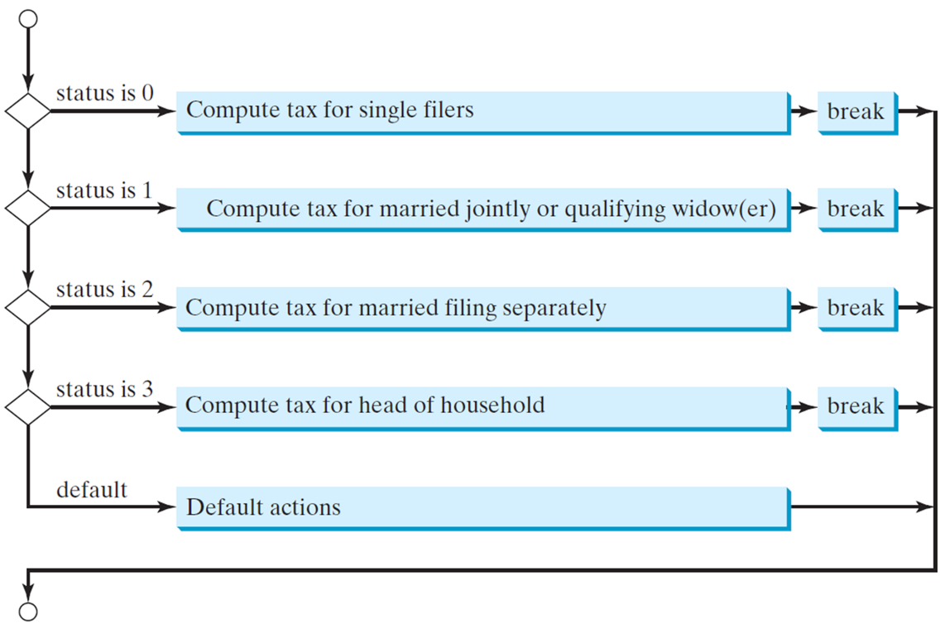
switch Statement Flow Chart
Notes:
An arrow starts from a point and moves to a decision box. If the status is 0, Compute tax for single filers, that leads to break.
If not, then move to status 1. If status is 1, Compute tax for married jointly or qualifying widow or widower, that leads to break.
If not, then move to status 2. If status is 2, Compute tax for married filing separately, that leads to break.
If not, then move to status 3. If status is 3, Compute tax for head of household, that leads to break.
if not, then move to default. If default, it leads to Default actions, that leads to the end point.
All the break points lead to the end point.

Slide 36
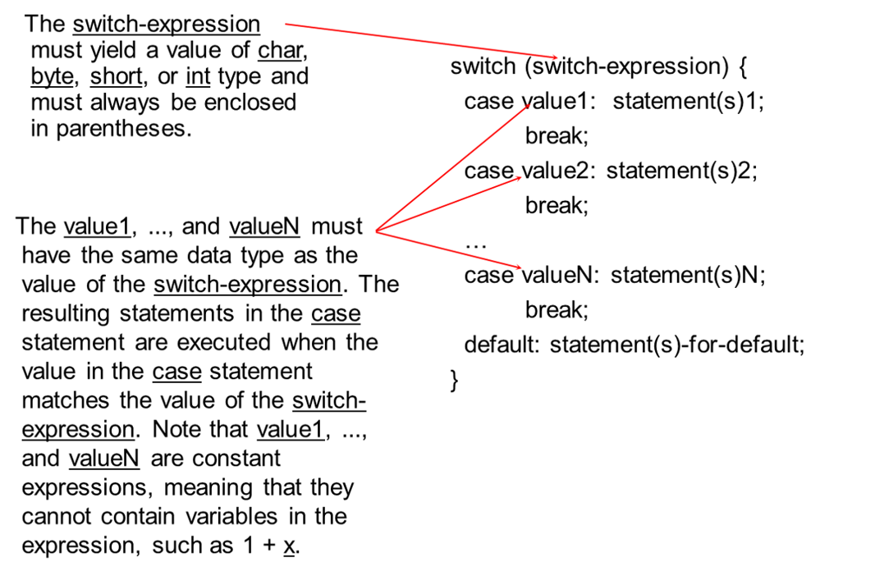
switch Statement Rules (1 of 2)
Notes:
The switch expression is connected to switch left parenthesis switch expression right parenthesis open curly brackets.
The value1, ..., and value N must have the same data type as the value of the switch-expression. The resulting statements in the case statement are executed when the value in the case statement matches the value of the switch-expression. Note that value 1, ..., and value N are constant expressions, meaning that they cannot contain variables in the expression, such as 1 + x.
Value N is connected to case value 1: statement or statements 1; break.
It is also connected to case value 2: statement or statements 2; break.
it is also connected to case value N: statement or statements N; break; default: statement or statements for default; close curly bracket.

Slide 37
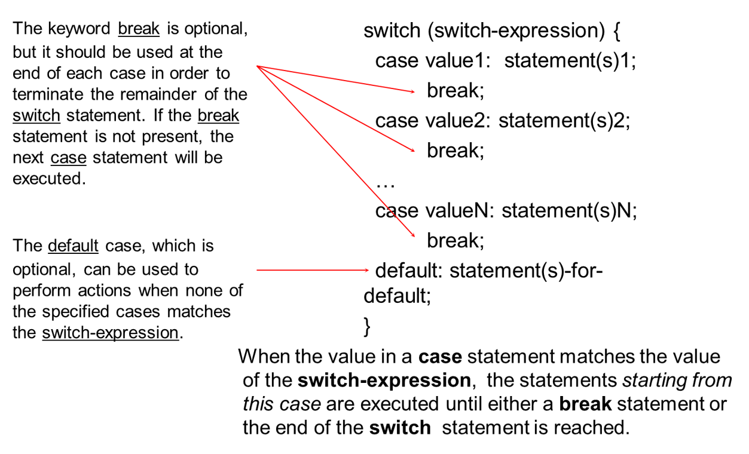
switch Statement Rules (2 of 2)
Notes:
The keyword break is optional, but it should be used at the end of each case in order to terminate the remainder of the switch statement. If the break statement is not present, the next case statement will be executed. It is connected to switch left parenthesis switch-expression right parenthesis open curly bracket case value 1: statement or statement 1; break; case value 2: statement or statements 2; break; ... case value N: statement or statements N; break;
The default case, which is optional, can be used to perform actions when none of the specified cases matches the switch-expression is connected to default: statement or statements -for-default; close curly bracket.

Slide 38
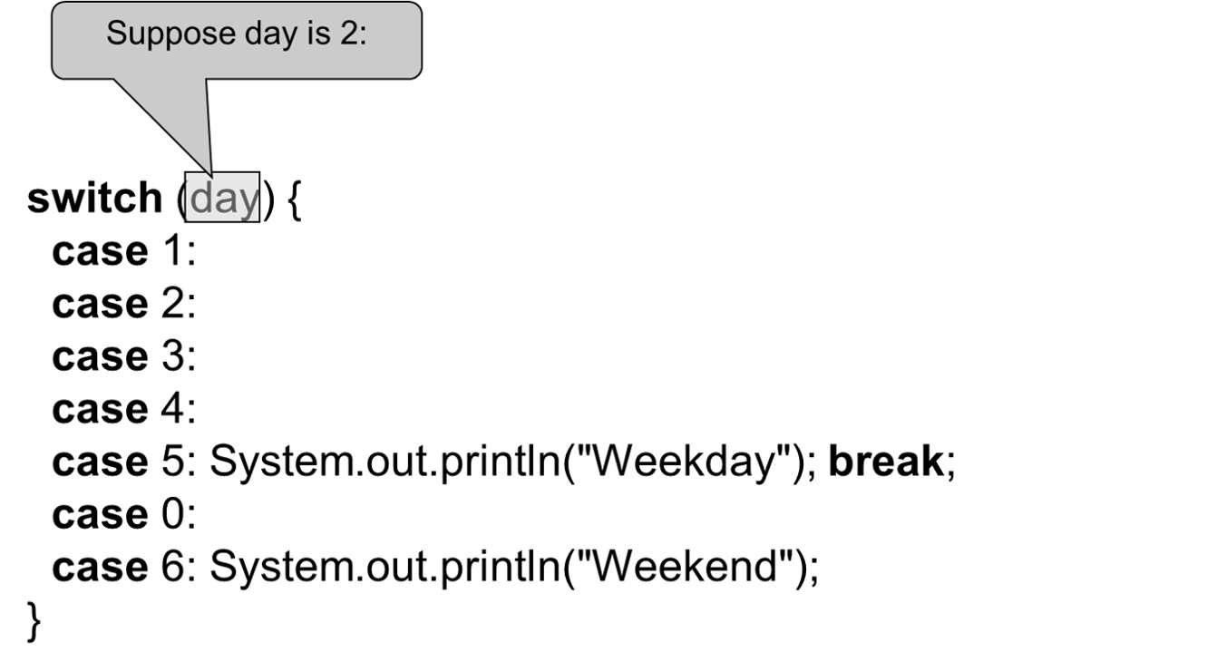
Trace switch Statement (1 of 7)

Slide 39
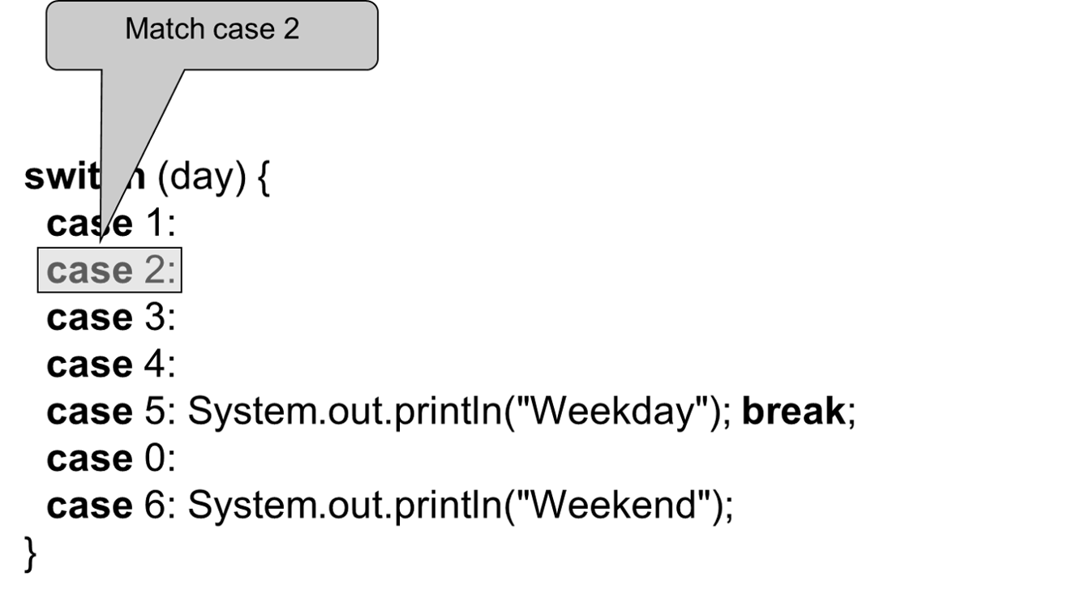
Trace switch Statement (2 of 7)

Slide 40
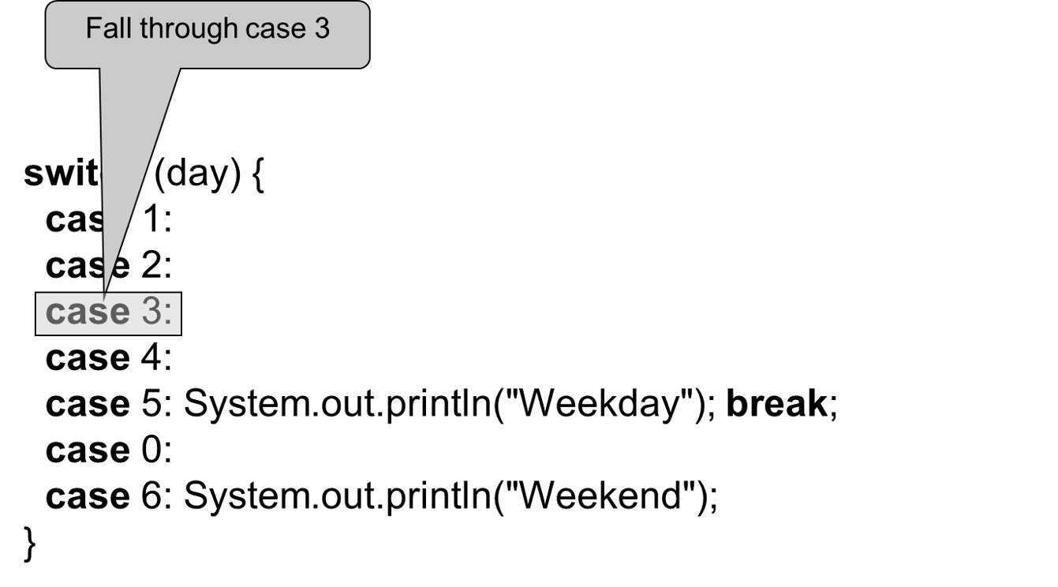
Trace switch Statement (3 of 7)

Slide 41
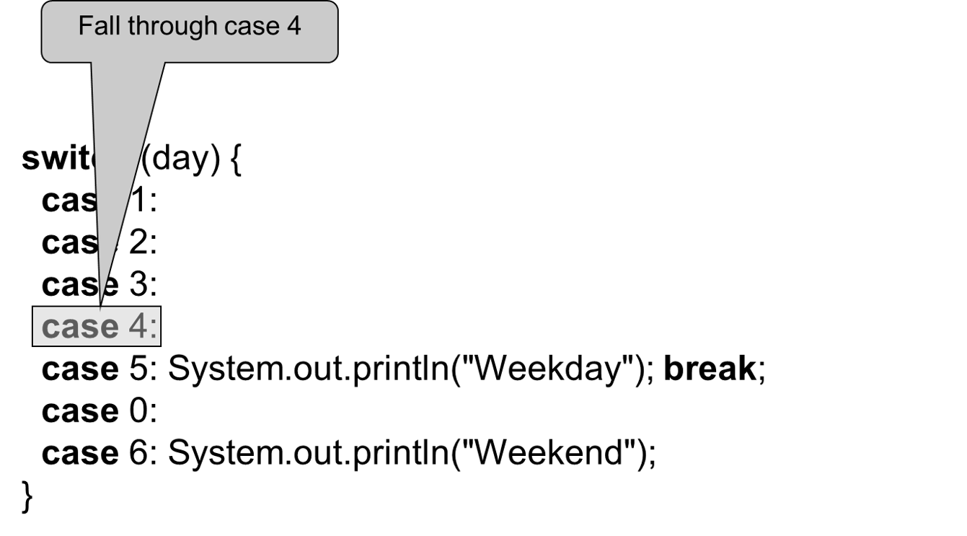
Trace switch Statement (4 of 7)

Slide 42
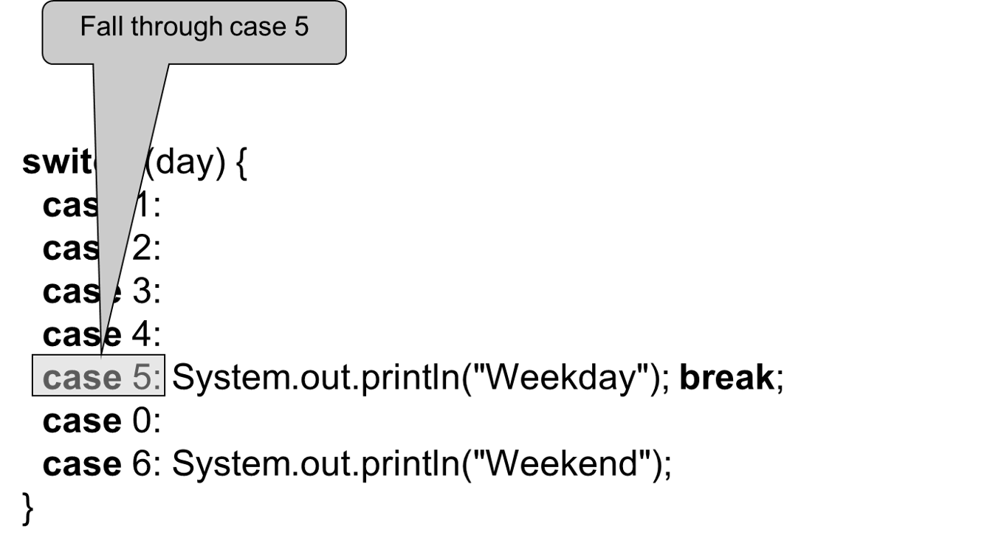
Trace switch Statement (5 of 7)

Slide 43
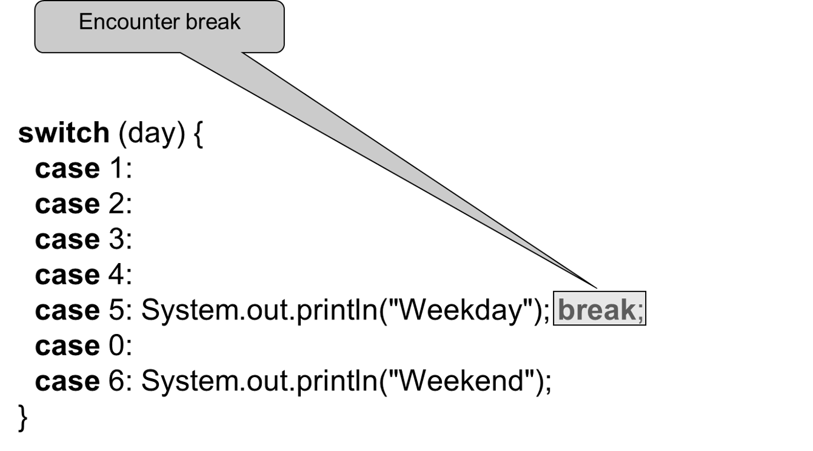
Trace switch Statement (6 of 7)

Slide 44
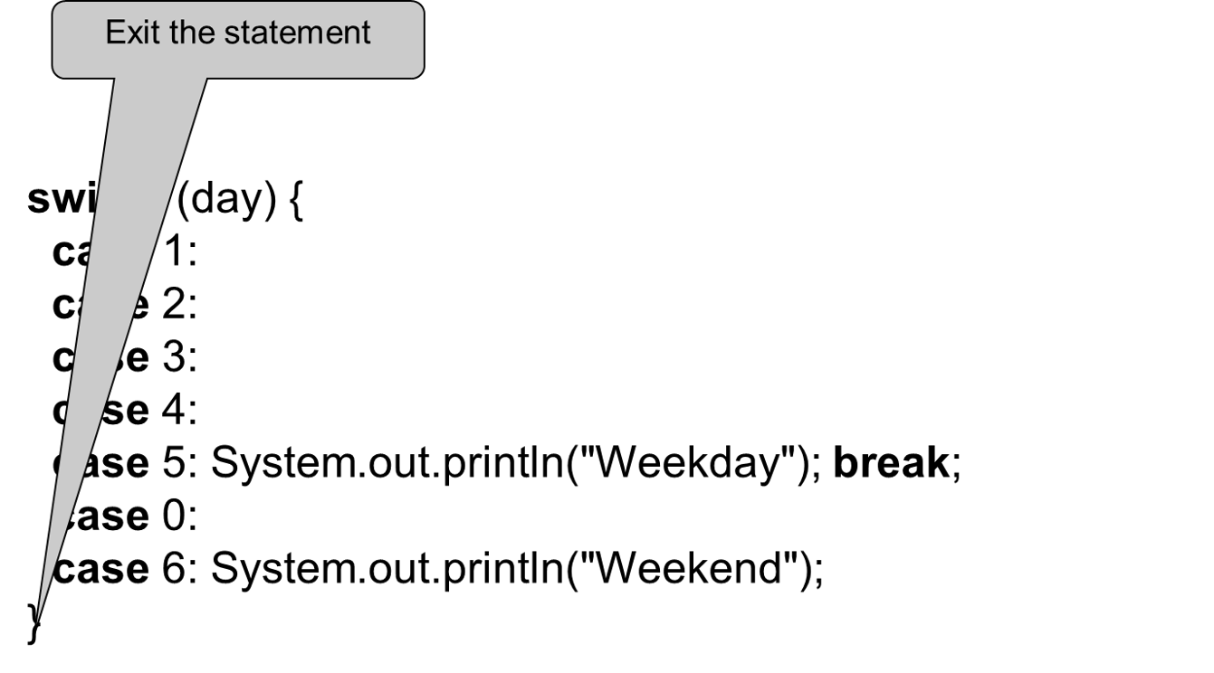
Trace switch Statement (7 of 7)

Slide 45
J D K 14 Arrow Operator (->)
Forgetting a break statement when it is needed is a common error. To avoid this type of errors, J D K 14 introduced a new arrow operator (->). You can use the arrow operator to replace the colon operator (:). With the arrow operator, there is no need to use the break statement. When a case is matched, the matching statement(s) are executed, and the switch statement is finished.
int day = 1;
switch (day) {
case 1 -> System.out.print(1 + " ");
case 2 -> System.out.print(2 + " ");
case 3 -> System.out.print(3 + " ");
}

Slide 46
J D K 14 switch Expression
Java 14 also introduced switch expressions. A switch expression returns a value. Here is an example:
int day = 1;
System.out.println(
switch (day) {
case 1 -> 1 + " ";
case 2 -> 2 + " ";
case 3 -> 3 + " ";
default -> " ";
}
);
The switch expression in this example returns a string. A switch expression must cover all cases, while a switch statement does not have to cover all cases. In the preceding example, the default clause is to required to cover the integers not listed in the cases.

Slide 47
J D K 14 switch Combining Cases
In Java 14, the cases can be combined. For example, the preceding code can be simplified as follows:
int day = 1;
System.out.println(
switch (day) {
case 1, 2, 3 -> day + " ";
default -> " ";
}
);
case 1, 2, 3 means case 1, case 2, or case 3.

Slide 48
The yield Keyword (1 of 2)
In Java 14, the cases can be combined. For example, the preceding code can be simplified as follows:
int day = 1;
System.out.println(
switch (day) {
case 1, 2, 3 -> day + " ";
default -> " ";
}
);
case 1, 2, 3 means case 1, case 2, or case 3.

Slide 49
The yield Keyword (2 of 2)
If the result for a matching case in a switch expression is not a simple value, you need to use the yield keyword to return the value. Here is an example,
int year = 2000;
int month = 2;
System.out.println(
switch (month) {
case 2 -> {
if (isLeapYear(year))
yield "29 days";
else
yield "28 days";
}
default -> " ";
}
);

Slide 50
Conditional Operators
if (x > 0)
y = 1
else
y = -1;
is equivalent to
y = (x > 0) ? 1 : -1;
(boolean-expression) ? expression1 : expression2
Ternary operator
Binary operator
Unary operator

Slide 51
Conditional Operator (1 of 2)
if (num % 2 == 0)
System.out.println(num + “is even”);
else
System.out.println(num + “is odd”);
System.out.println(
(num % 2 == 0)? num + “is even” :
num + “is odd”);

Slide 52
Conditional Operator (2 of 2)
boolean-expression ? exp1 : exp2

Slide 53
Operator Precedence
var++, var--
+, - (Unary plus and minus), ++var,--var
(type) Casting
! (Not)
*, /, % (Multiplication, division, and remainder)
+, - (Binary addition and subtraction)
<, <=, >, >= (Relational operators)
==, !=; (Equality)
^ (Exclusive OR)
&& (Conditional AND) Short-circuit AND
|| (Conditional OR) Short-circuit OR
=, +=, -=, *=, /=, %= (Assignment operator)

Slide 54
Operator Precedence and Associativity
The expression in the parentheses is evaluated first. (Parentheses can be nested, in which case the expression in the inner parentheses is executed first.) When evaluating an expression without parentheses, the operators are applied according to the precedence rule and the associativity rule.
If operators with the same precedence are next to each other, their associativity determines the order of evaluation. All binary operators except assignment operators are left-associative.

Slide 55
Operator Associativity
When two operators with the same precedence are evaluated, the associativity of the operators determines the order of evaluation. All binary operators except assignment operators are left-associative.
is equivalent to
Assignment operators are right-associative. Therefore, the expression
is equivalent to

Slide 56
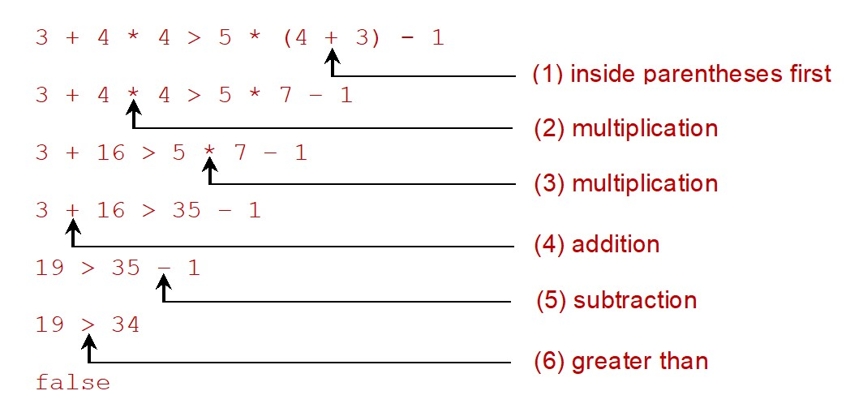
Example
Applying the operator precedence and associativity rule,
the expression
is evaluated as
follows:
Notes:
Row 1. 3 + 4 times 4 greater than 5 times left parenthesis 4 + 3 right parenthesis minus 1. The plus sign in the brackets is labeled, 1. inside parenthesis first.
Row 2. 3 + 4 times 4 greater than 5 times 7 minus 1. The multiplication symbol between the two 4s is labeled as, 2. multiplication.
Row 3. 3 + 16 greater than 5 times 7 minus 1. The multiplication symbol between 5 and 7 is labeled as, 3. multiplication.
Row 4. 3 + 16 greater than 35 minus 1. The plus sign between 3 and 16 is labeled, 4. addition.
Row 5. 19 greater than 35 minus 1. The minus sign between 35 and 1 is labeled as, 5. Subtraction.
Row 6. 19 greater than 34. The greater than symbol between 19 and 34 is labeled as, 6. greater than.
Row 7. false.

Slide 57
Debugging
Logic errors are called bugs. The process of finding and correcting errors is called debugging. A common approach to debugging is to use a combination of methods to narrow down to the part of the program where the bug is located. You can hand-trace the program (i.e., catch errors by reading the program), or you can insert print statements in order to show the values of the variables or the execution flow of the program. This approach might work for a short, simple program. But for a large, complex program, the most effective approach for debugging is to use a debugger utility.

Slide 58
Debugger
Debugger is a program that facilitates debugging. You can use a debugger to
Execute a single statement at a time.
Trace into or stepping over a method.
Set breakpoints.
Display variables.
Display call stack.
Modify variables.

